Slide 1

Segmenting and Clustering Neighbourhoods in Toronto
IBM Data Science Capstone Project
Amira Kaskasoli

Slide 2


The problem
A client wants to move to Toronto and would like to know the most suitable neighbourhoods for him to narrow his house search down to.
The Criteria: proximity to
Coffee shops
Italian restaurants
Exercise facilities

Slide 3

The Data
Wikipedia list of Toronto postal codes, boroughs and neighbourhoods
Geospatial data of latitude and longitude of each neighbourhood
Foursquare location data on venues in each location

Slide 4
Methodology
Merge postal code data with geospatial coordinates data of each neighbourhood
Visualise neighbourhoods on a map using Folium
Use Foursquare API location data to retrieve popular venues within 500m radius of each location
Create dataframe with TOP 10 common venues per neighbourhood
Use K-means clustering to cluster neighbourhoods by similar venues
Assess clusters using client requirements

Slide 5
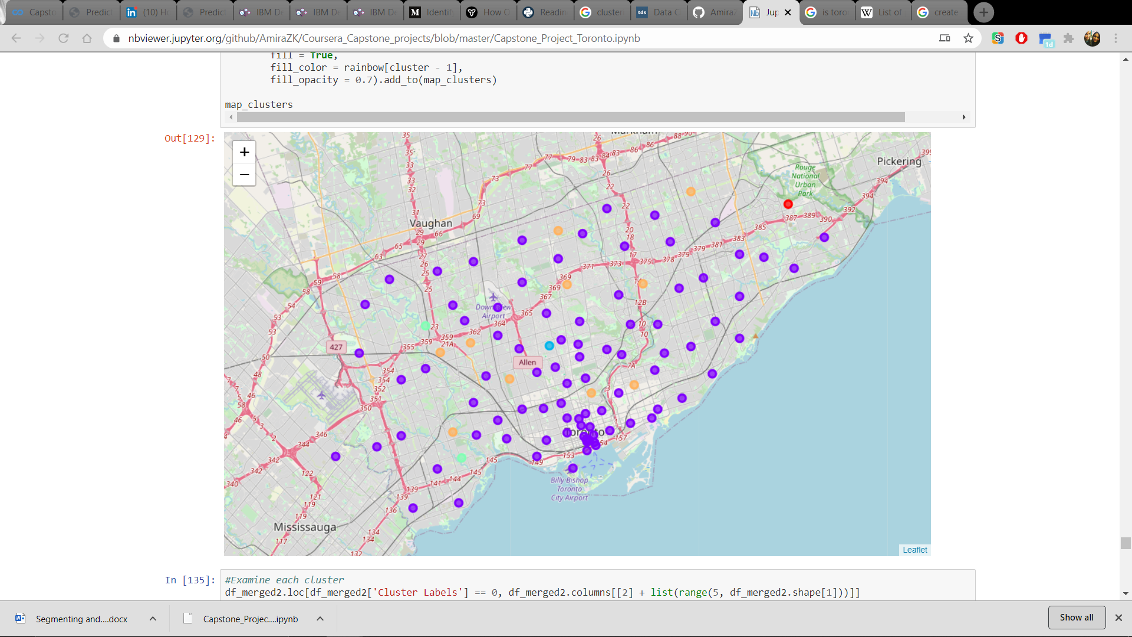
Results
Cluster 1: Neighbourhoods: 1. Venues: NA
Cluster 2: Neighbourhoods: 86. Venues: Italian Restaurant, Coffee Shop, Yoga Studio, Gym, Athletics & Sports
Cluster 3: Neighbourhoods: 1. Venues: Yoga Studio
Cluster 4: Neighbourhoods: 2. Venues: Basketball Field, Yoga
Cluster 5: Neighbourhoods: 10. Venues: Park, Yoga, Coffee Shop.

Slide 6

Discussion & Conclusion
Cluster 2 contains the most appropriate neighbourhoods that meet the criteria of proximity to coffee shops, Italian food and exercise facilities.
The client should use the interactive folium map provided to explore house listings in neighbourhoods shown in purple.
Future analysis should include assessing historic house listings in Toronto neighbourhoods to compare affordable locations to buy in.

